Slide 1
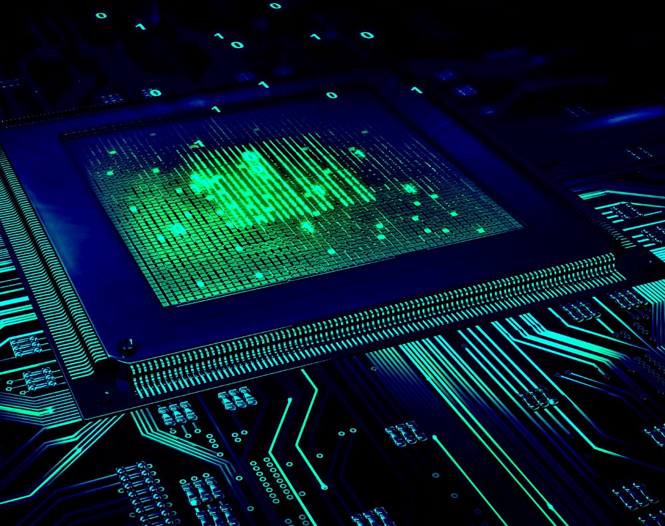
Cache Memory & Virtual Memory
Prakhar Bansal 19CSU215

Slide 2

Table of Contents
Cache Memory
Functioning of Cache Memory
Types of Cache Memory
Application of Cache Memory
Virtual Memory
Functioning of Virtual Memory
Types of Virtual Memory
Application of Virtual Memory

Slide 3

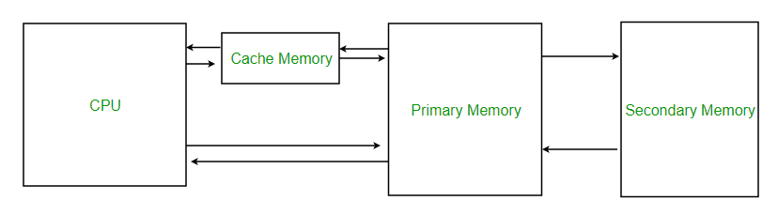
Cache Memory
Cache memory is an extremely fast memory type that acts as a buffer between RAM and the CPU. It holds frequently requested data and instructions so that they are immediately available to the CPU when needed.
Cache memory is used to reduce the average time to access data from the Main memory.

Slide 4
Functioning of Cache Memory
Whenever the CPU wants to access memory, it first checks whether what it needs resides in the cache memory. If yes, it would be able to access it with the least latency. If it does not reside in cache, then the requested content would be copied from RAM to the cache and then only the CPU will access it from the cache. Here, when copying content from the cache, not only the content in the requested memory address but also the nearby content is copied to cache. So, the next time there is a high probability for a cache hit to occur as most computer programs access nearby data or last accessed data most of the times. So due to the cache, the average memory latency is reduced.

Slide 5

Types of Cache
Primary Cache – A primary cache is always located on the processor chip. This cache is small and its access time is comparable to that of processor registers.
Secondary Cache – Secondary cache is placed between the primary cache and the rest of the memory. It is referred to as the level 2 (L2) cache. Often, the Level 2 cache is also housed on the processor chip.

Slide 6

Applications of Cache Memory
Usually, the cache memory can store a reasonable number of blocks at any given time, but this number is small compared to the total number of blocks in the main memory.
The correspondence between the main memory blocks and those in the cache is specified by a mapping function.

Slide 7

Virtual Memory
Virtual memory is a memory management technique where secondary memory can be used as if it were a part of the main memory. Virtual memory is a very common technique used in the operating systems (OS) of computers.

Slide 8
Functioning of Virtual Memory
When a program is started, it is given a virtual address space that can be even larger than the actual physical memory. Virtual memory space is also divided into chunks called pages and each of this virtual memory page can be mapped to a physical page. The table called page table keep track of this mapping. When the physical memory runs out of space, what is done is, certain physical pages are pushed to that special portion in the hard disk. When any page pushed to the hard disk is needed again, it is brought to the physical memory by putting another selected page from the physical memory to the hard disk.

Slide 9
Types of Virtual Memory
Paged Virtual Memory : Paging divides memory into sections or paging files, usually approximately 4 KB in size. When a computer uses up its RAM, pages not in use are transferred to the section of the hard drive designated for virtual memory using a swap file.
Segmented Virtual Memory : Segmentation is also used to manage virtual memory. This approach divides virtual memory into segments of different lengths. Segments not in use in memory can be moved to virtual memory space on the hard drive. Segmented information or processes are tracked in a segment table, which shows if a segment is present in memory, whether it's been modified and what its physical address is.

Slide 10
Applications of Virtual Memory
Increases security because of memory isolation.
Frees applications from managing shared memory and saves users from having to add memory modules when RAM space runs out.
Multiple larger applications can be run simultaneously.
We can allocate memory really cheap

Slide 11
THANK YOU

